Slide 1
Lanthanide doping
Solid Samples

Slide 2
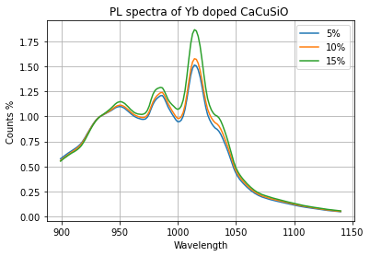



$$Ca_{1−x}CuSi_{4}O_{10}:Yb_{x}$$
Strong candidate
High fluorescence
High temperature dep.
Very narrow$(x_axis)$ gaps
Normalisation Peak $≈$ $2∙{10}^{4}$ counts
750nm @ 30-40%

Slide 3
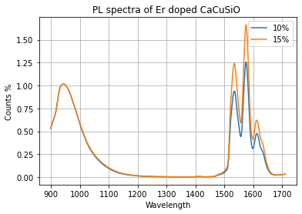


$$Ca_{1−x}CuSi_{4}O_{10}:Er_{x}$$
Strong candidate
High fluorescence
High temperature dep.
High setup dependence
SHG
Normalisation Peak $≈3∙{10}^{4}$ counts
750nm @ 30-40%

Slide 4
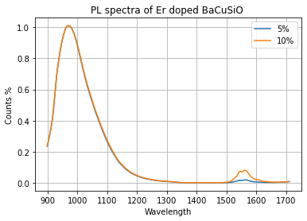


$$Ba_{1−x}CuSi_{4}O_{10}:Er_{x}$$
Weak dopand contribution
Normalisation Peak $≈3∙{10}^{4}$ counts
750nm @ 30-40%

Slide 5
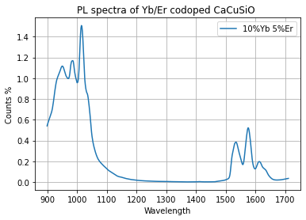


$$Ca_{1−(x+y)}CuSi_{4}O_{10}:Yb_{x}Er_{y}$$
Promising Candidate
High fluorescence
TBC
Normalisation Peak $≈2∙{10}^{4}$ counts
5%Yb 2.5%Er
750nm @ 30-40%

Slide 6
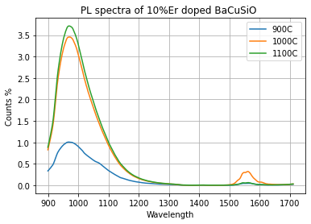


Temperature dependence of $$Ba_{1−x}CuSi_{4}O_{10}:Er_{x}$$
Erbium seams to dislike 1000+C
750nm @ 30-40% & 100% for 900C
Normalisation Peak $≈4∙{10}^{3}$ counts

Slide 7

Lanthanide doping
Thermal sensing of $Ca_{1−x}CuSi_{4}O_{10}:Yb_{x}$
(750nm Laser @ 70%)

Slide 8
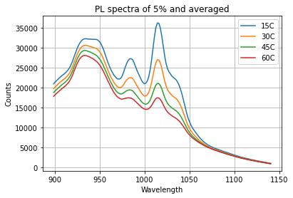
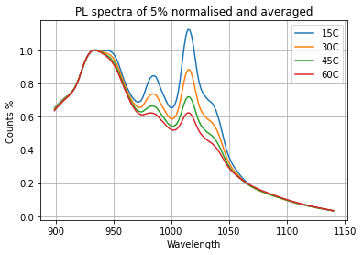

$$Ca_{1−0.05}CuSi_{4}O_{10}:Yb_{0.05}$$

Slide 9
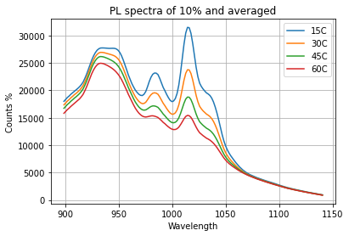
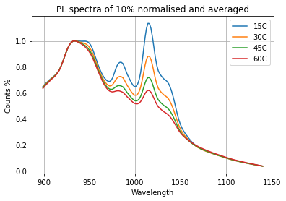

$$Ca_{1−0.10}CuSi_{4}O_{10}:Yb_{0.10}$$

Slide 10
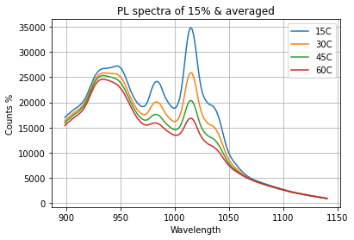
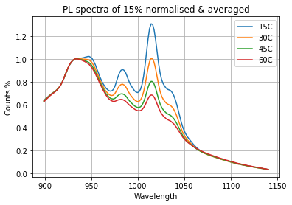

$$Ca_{1−0.15}CuSi_{4}O_{10}:Yb_{0.15}$$

Slide 11

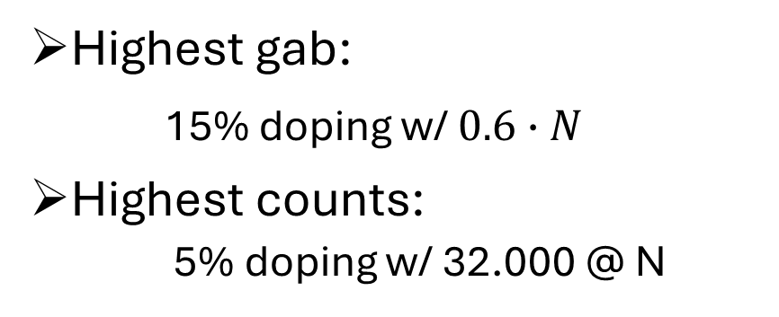
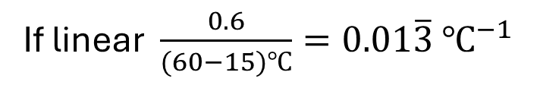
Specifics
Highest gab:
15% doping w/ $0.6∙N$
Highest counts:
5% doping w/ 32.000 @ N
$$⇒$$
If linear $\frac{0.6}{(60−15)℃}=0.01\overline{3} ℃^{−1}$
Improve measurement
Decrease temp. changes

Slide 12

Lanthanide doping
Thermal sensing of $Ca_{1−x}CuSi_{4}O_{10}:Er_{x}$
(750nm Laser @ 70%)

Slide 13
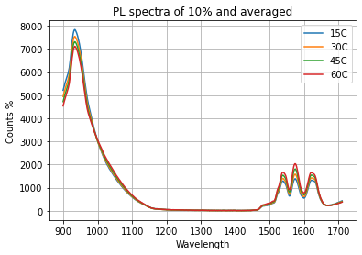
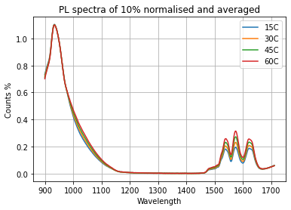

$$Ca_{1−0.10}CuSi_{4}O_{10}:Er_{0.10}$$

Slide 14
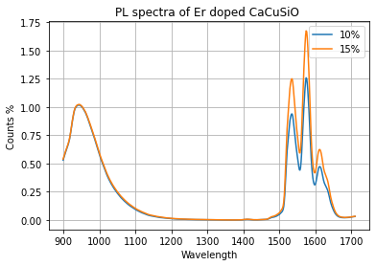
Comparison
Less overall counts
Smaller Gab
Same sample, different setup
Higher Luminescence
Better dopant respond
$⇒$Improve setup, then promising and worth a comparison!

